Slide 1
Data processing, Data quality and copyright
A quick series of remarks on the pitfalls of trusting the process and your data providers
Luc Girod
GEO(3|4)460 – Spring 2025

Slide 2
The data processing pipeline
Input data
Processing
Results

Slide 3
The data processing pipeline – in theory
Great, complete input data
Competent processing through the appropiate tool(s)
Convincing results

Slide 4
The data processing pipeline – in theory
Surprising?
Really?
Great, complete input data
Competent processing through the appropiate tool(s)
Convincing results
Coherent?
How so?
Expected?

Slide 5
Validating results – difference from expectations
In accordance to a priori – can be logically explained
Not raising alarm – no strong a priori
Different from expectations – defies a priori

Slide 6
Validating results – using ground truth
Input data
Processing
Results
Coherent?
Coherent is not necessarilly identical
Validation data
On some limited sample points
From another point in time (expected constistency through time)
From another location (expected statistical similarity)

Slide 7
Validating results – through another data source
Input data 1
Processing
Results
Comparison
Input data 2
Processing
Results
Coherent?
Different types
Different sources
Coherent is not necessarilly identical

Slide 8
Validating results – through another processing method
Input data 1
Processing 1
Results
Comparison
Input data
Processing 2
Results
Coherent?
Different methods
Different software
Coherent is not necessarilly identical

Slide 9
What if the results aren’t convincing?
Great, complete input data
Competent processing through the appropiate tool(s)
Unconvincing results

Slide 10
The data processing pipeline – good Processing
Novice user
Complex processing
Wide range of options
Check your work
Were there warnings or error messages?
Read tool(s) documentation
Is the tool appropriate for the task?
Is the input data appropriate for the tool?
Are there options I forgot to (de)activate?
Great, complete input data
Competent(?) processing through the appropiate (?) tool(s)
Unconvincing results

Slide 11
The data processing pipeline – good input?
Badly formatted data
Data needing pre-processing
Data with errors
Check input data
Reliable source? (Official source vs ‘somewhere online’)
Appropriate for the tools (formating details can have big impact, check the tool documentation for info)
Verify data integrity after topological operation!
Not that great input data
Competent processing through the appropiate tool(s)
Unconvincing results

Slide 12

Scenarios with bad data
The tool refuses it and gives a usefull error message
The tool refuses it with a generic error
The tool crashes
The tool accepts the bad data
Severity of the issue

Slide 13
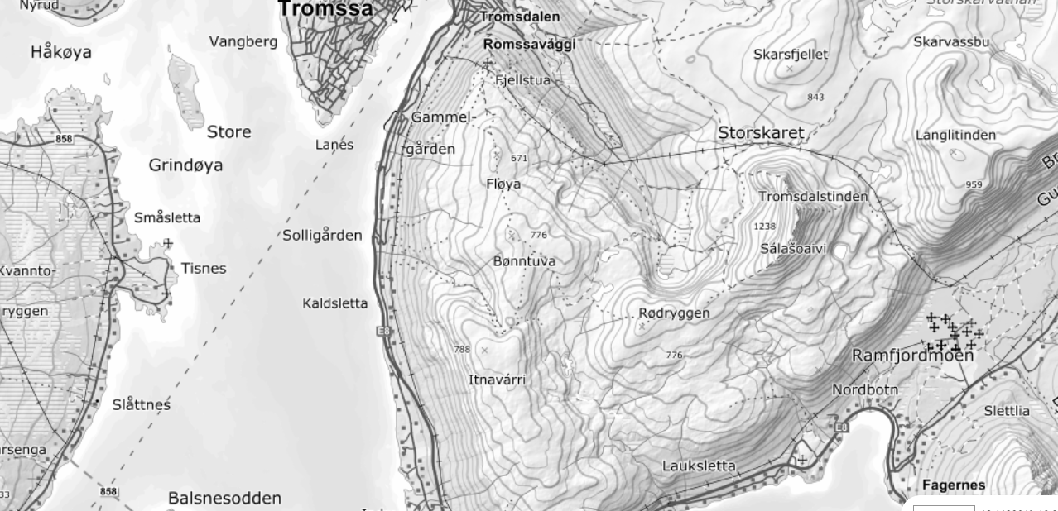
An example – topo data in tromsø to dem

Slide 14
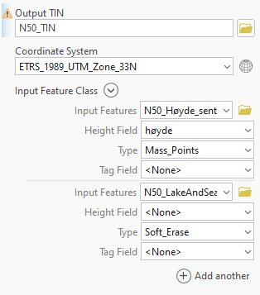
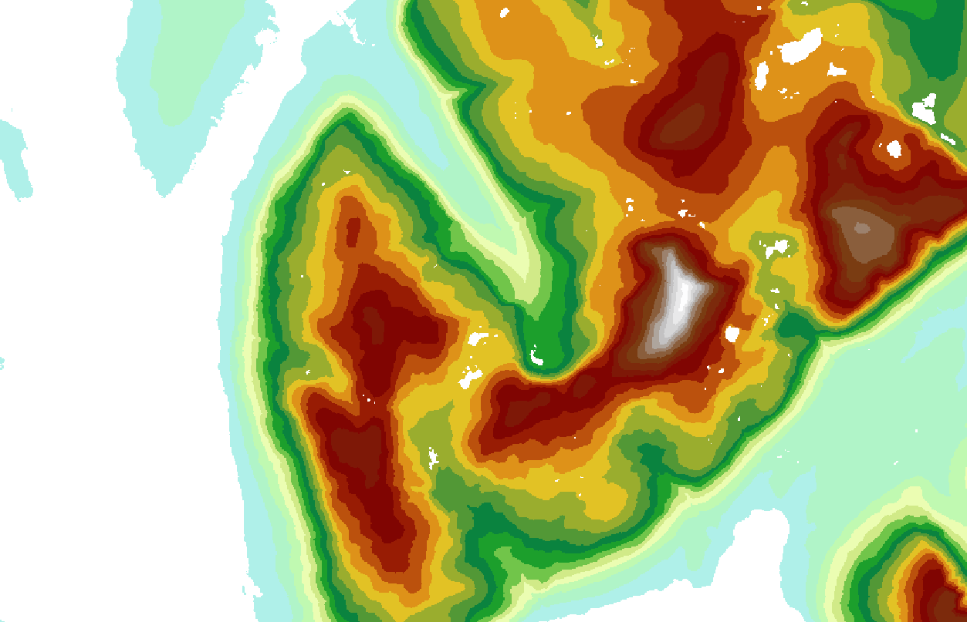

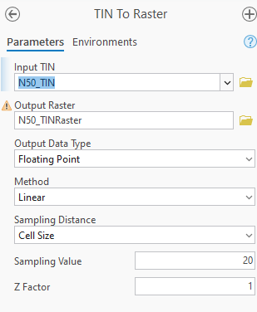
TIN to Raster seems looks reasonable, but let’s validate

Slide 15
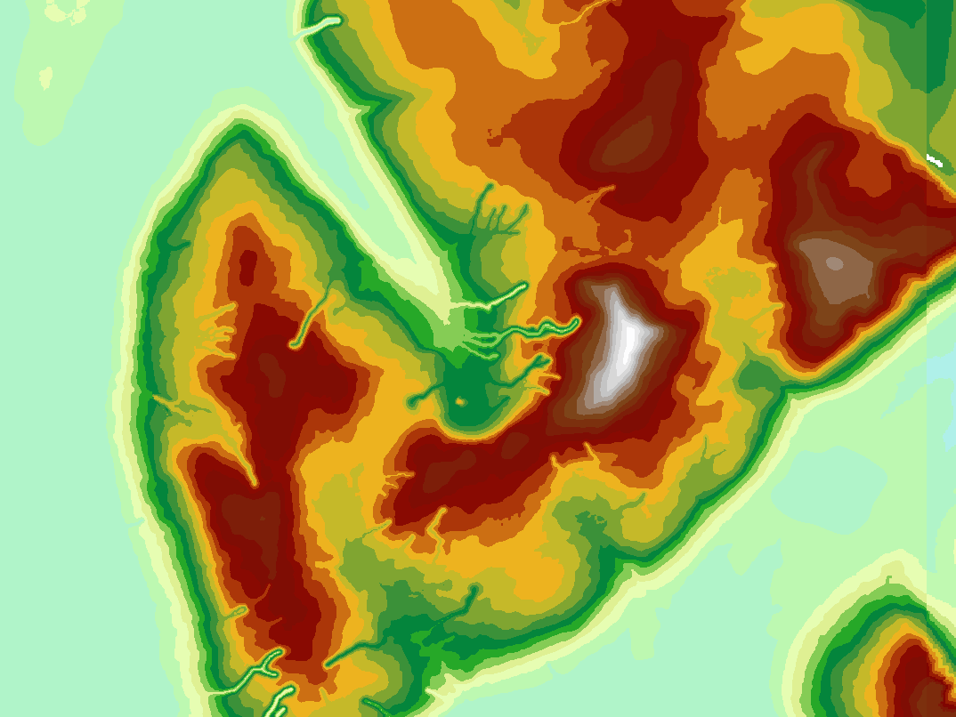
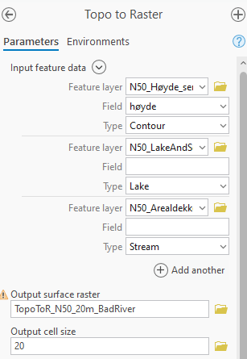

Topo to raster is…weird

Slide 16
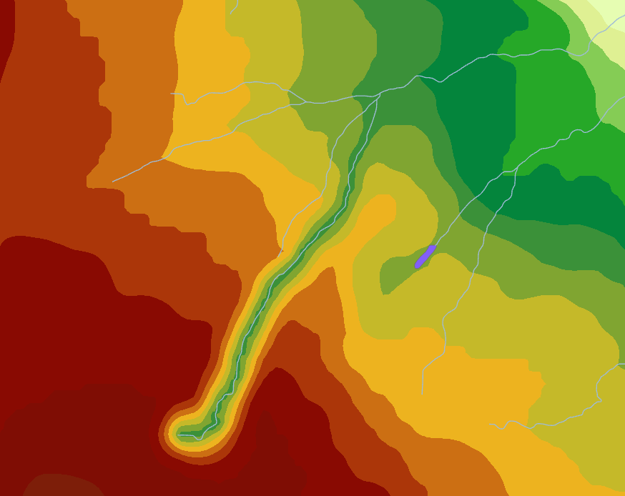
What’s That????
STOOOOOOOOOP
There’s probably an issue with the input data!!!!!
Difference between TIN Raster and Topo to Raster reach hundreds of meter
Canyons seem to have formed along SOME rivers
The tools were used properly (checked!)

Slide 17
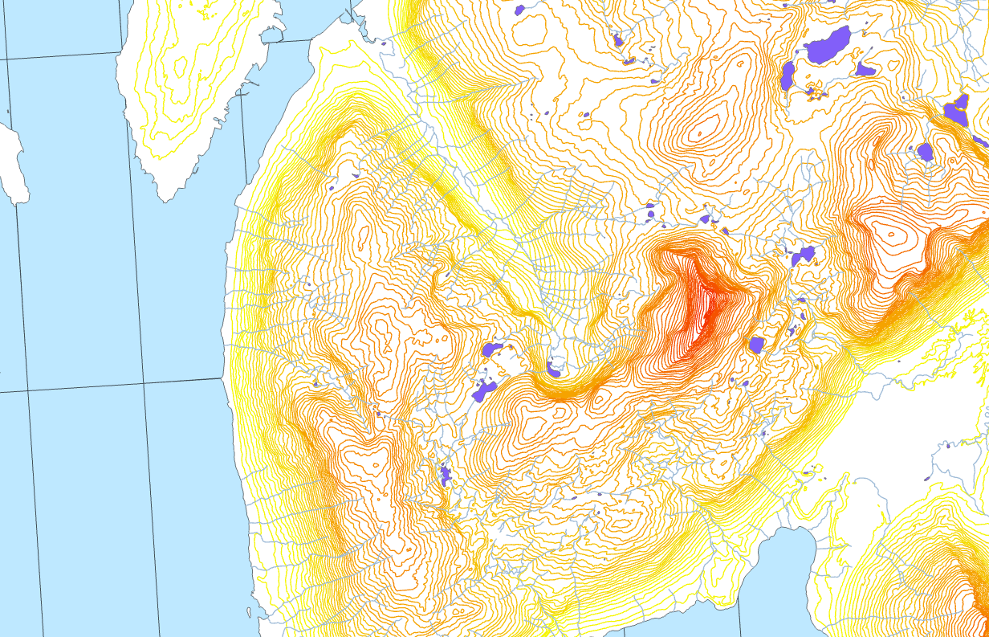
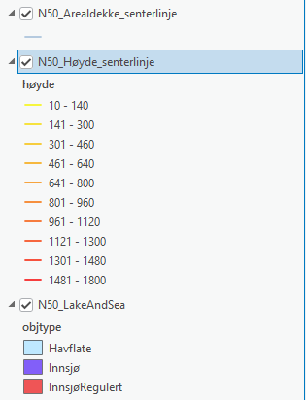
Data is from a trustworthy source

Slide 18
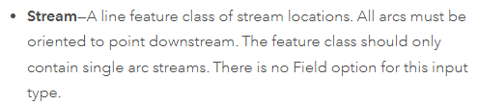
Figuring out the issue
The river seem to have an undesirable effect…sometimes
They are used in the Topo to Raster tool through the ‘Stream’ option
Let’s lookup the doc : https://pro.arcgis.com/en/pro-app/latest/tool-reference/spatial-analyst/topo-to-raster.htm

Slide 19
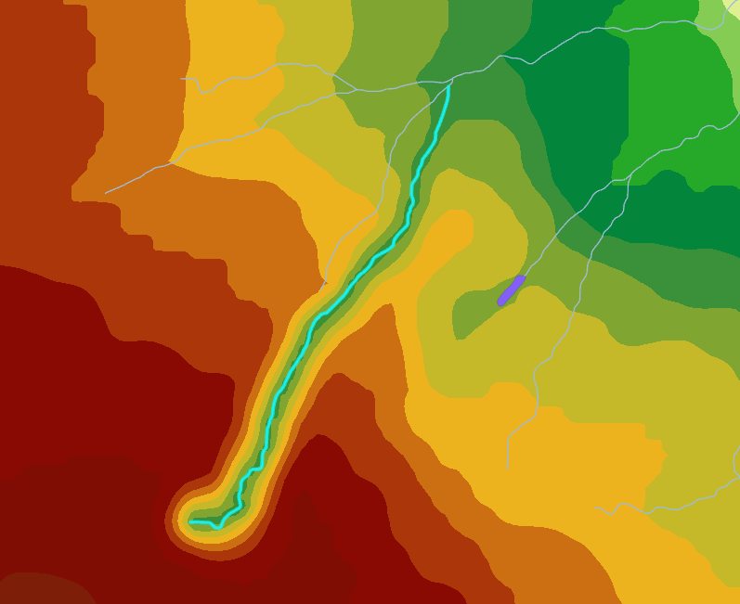
Single arc streams?
Each stream has to be a simple arc, not a multi-line
Edit→select→stream are selected individually, so they are ‘single arcs’

Slide 20
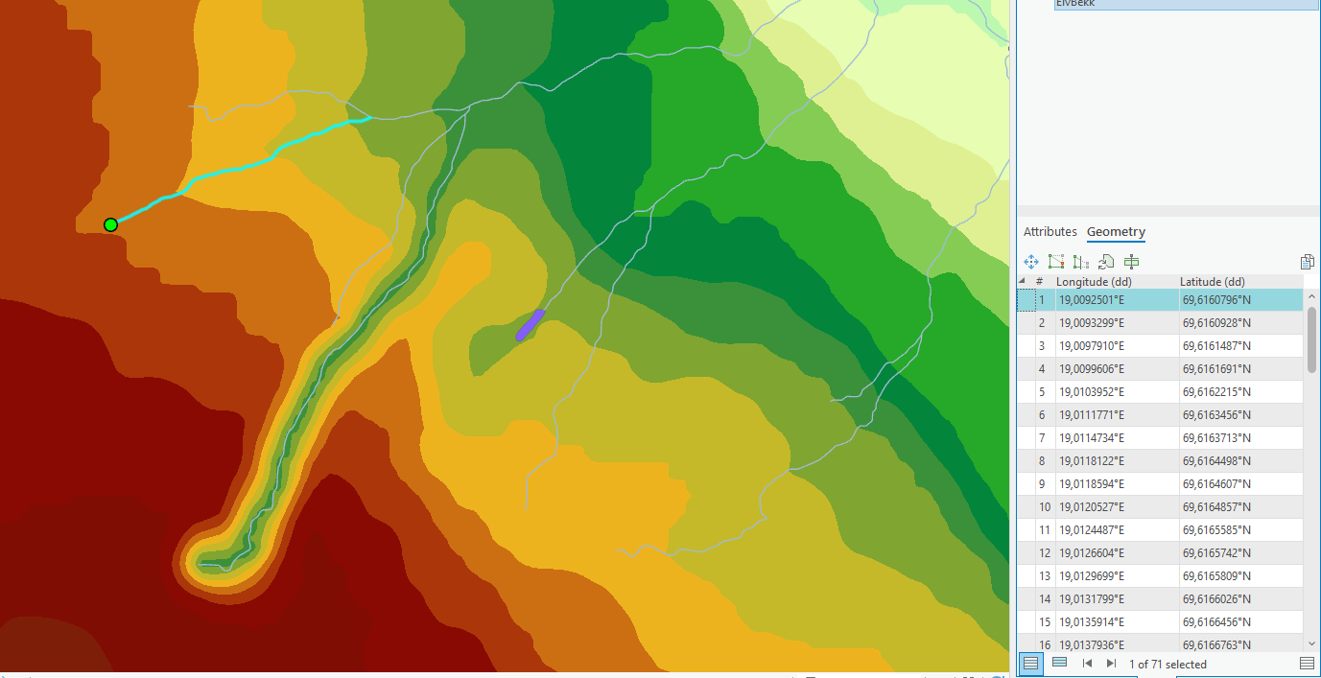
Oriented to point downstream?
Edit→ attribute→geometry
Non-problematic arcs have their first point at the source/high point of the river section

Slide 21
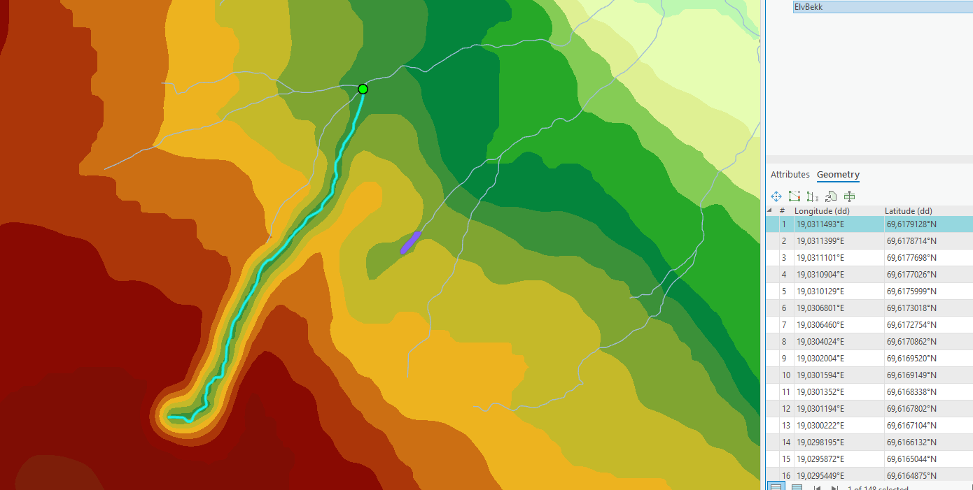
Oriented to point downstream?
Problematic arcs have their first point at the end/low point of the river section
This forces the Topo to Raster tool to create a raster where the high point is lower than the low point

Slide 22
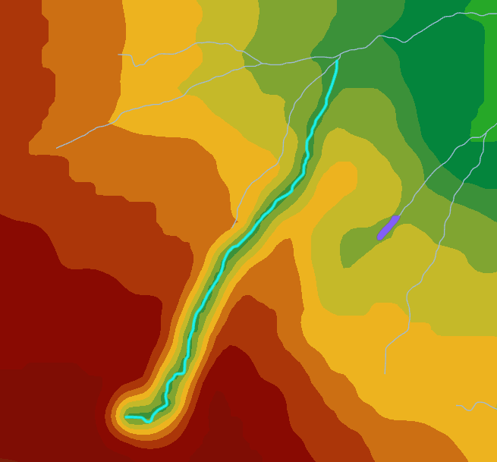
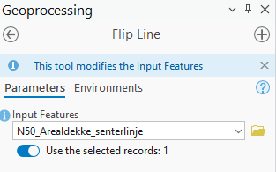
Solving the issue
Select all bad lines
Run Flip Line

Slide 23
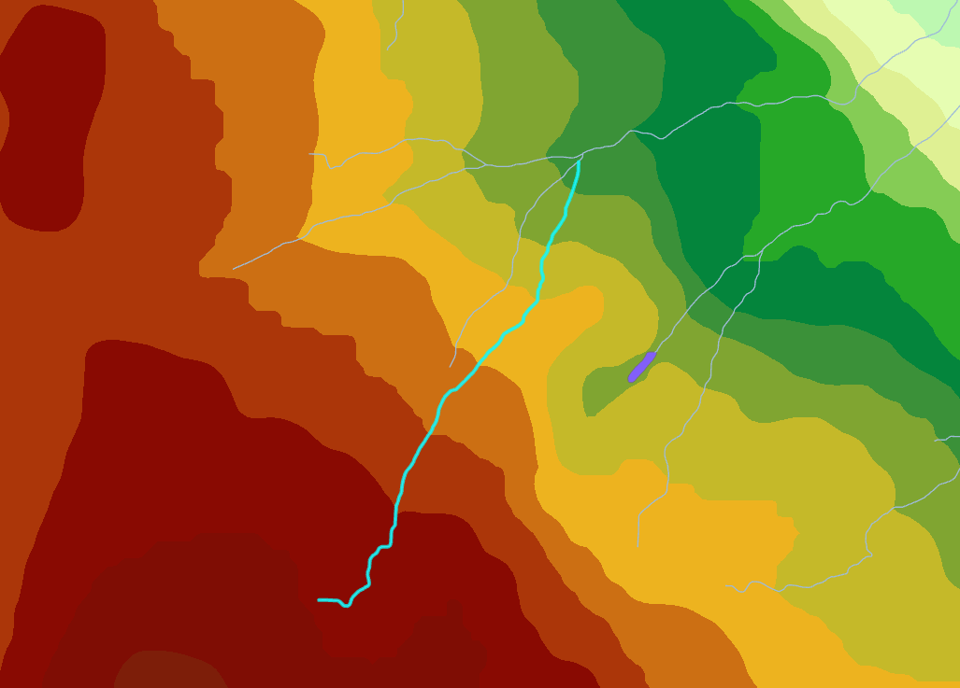
Re-running the tool on cleaned data → Success!!!

Slide 24
Well…
Manually fixing all those rivers would be quite the task.
On could design an automated tool:
Compute a TIN based DEM
Compute the elevation of all start and end nodes in the stream lines
Compare the values
Flip the line if the start point is lower than the end.

Slide 25
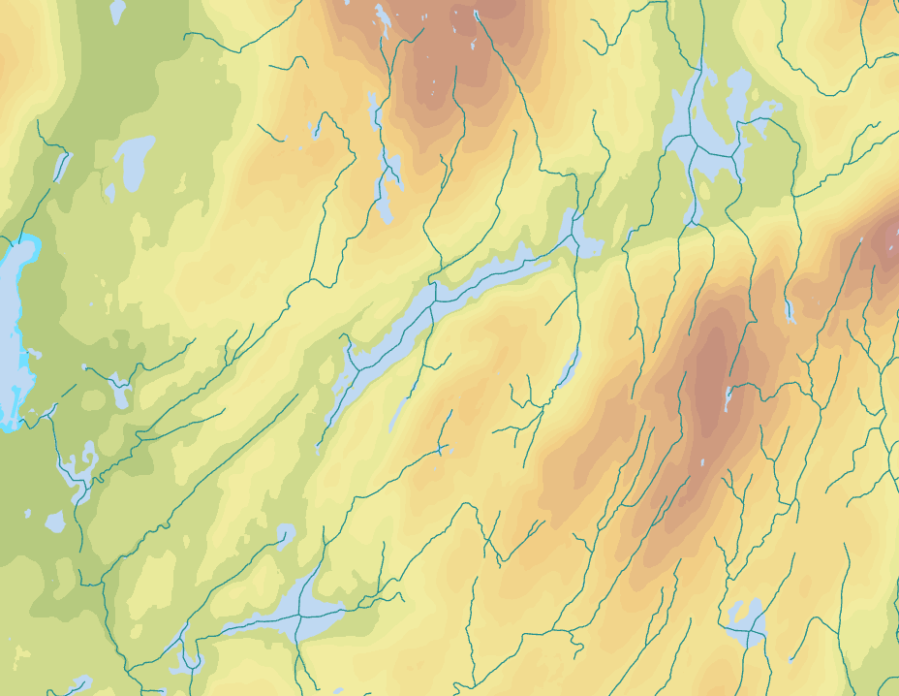
Another location
In Bergen, the issue is also widespread, and made worse (better?) by having a lot of lakes that the streams og through. Having those lakes AND rivers in the process leads to a crash as the forced gradients from the river cannot be reconciled with the forced flatness of lakes,

Slide 26
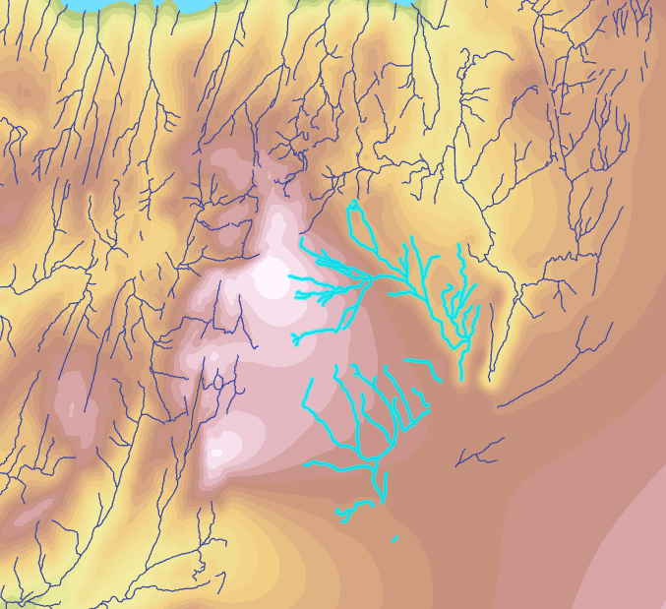
Try another data source
Trying the Miljødirektoratet Vannforekomster dataset didn’t help, as it didn’t satisfy the ‘single arc’ requierment of the Topo To Raster tool.
A single polyline is selected in this figure →

Slide 27
Data is from a trustworthy source…but
Even trustworthy data providers might not provide data that is fit for YOUR purpose!

Slide 28
A few notes on copyright and licenses
(Geographical) data is expensive to capture, process, and distribute
Data distributor are free to decide how their data is distributed:
Free? Paid? Only accessible to designated/cleared users?
Restrictions on use? Only in science/public service, all BUT some applications…
Restrictions on redistribution? Data is often only meant to be obtained from the source
Requirements for credit? Oftentimes a small ©Data Provider is necessary.

Slide 29
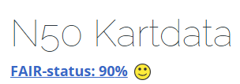
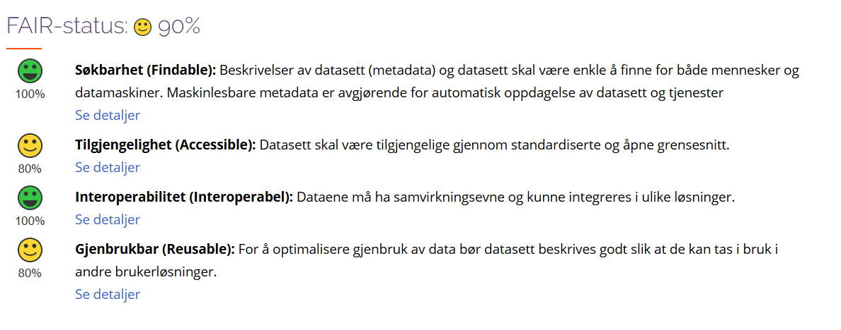
FAIR data
FAIR
Findability, Accessibility, Interoperability, and Reusability

Slide 30
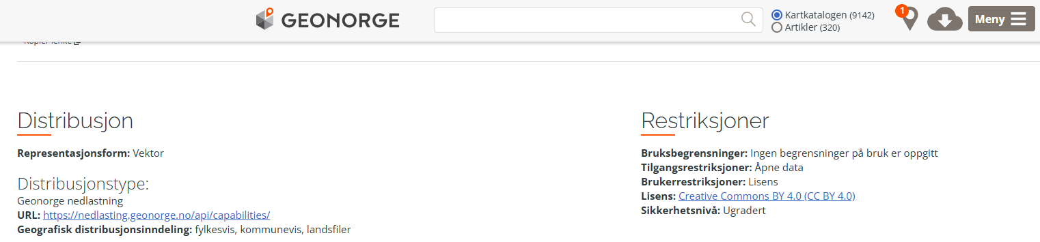
Distribution – license

Slide 31
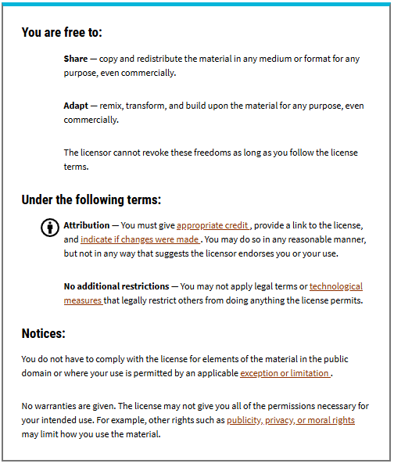
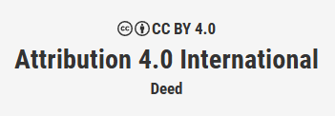
Distribution – license
https://creativecommons.org/licenses/by/4.0/

Slide 32
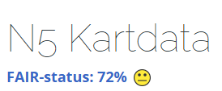
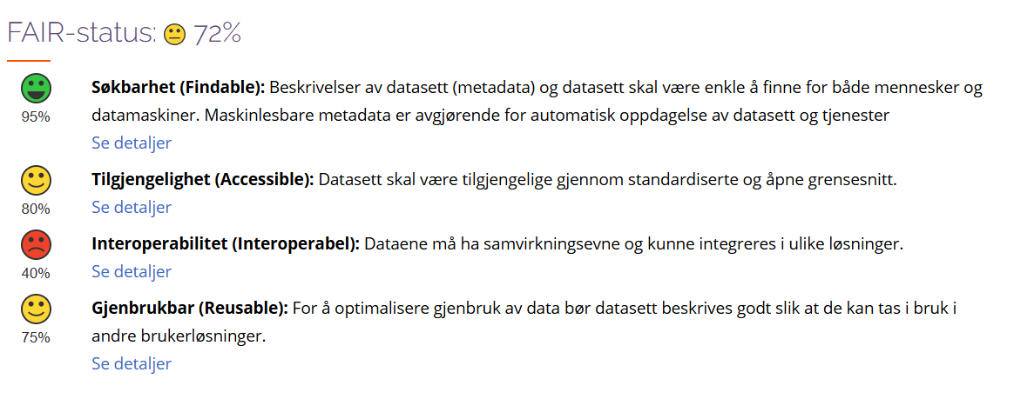
FAIR data
FAIR
Findability, Accessibility, Interoperability, and Reusability

Slide 33
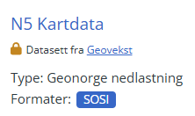
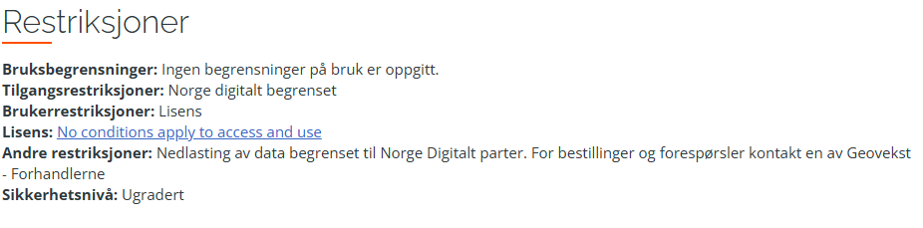
Distribution
FAIR
Findability, Accessibility, Interoperability, and Reusability

Slide 34
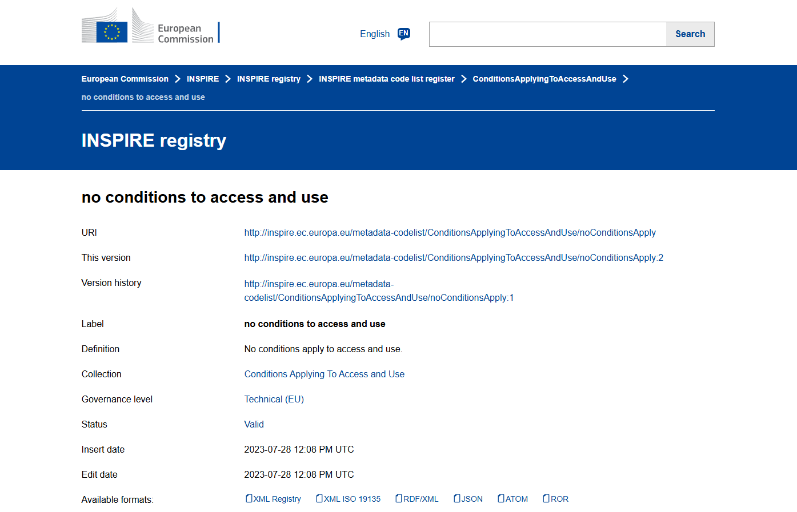
License

Slide 35
Conclusion
Data isn’t always good
Data isn’t always free
Data isn’t always easy to access
Data and tools don’t always work well together, but a bit of convincing might help
If your results look weird or disagree with other part of your work, don’t brush it off, figure out what’s up!
Thank you for coming to my TedTalk!

